Slide 1
UNIT-III
Descriptive analytics:
Data Modeling
Trend Analysis
Simple Linear Regression Analysis

Slide 2
Descriptive analytics
Descriptive analytics in data mining refers to the process of analyzing historical data to summarize and understand patterns, trends, and relationships within it.
Purpose
Provides insights into historical data.
Helps organizations understand past behaviors, performance, and outcomes.
Serves as the foundation for more advanced analytics (predictive and prescriptive).

Slide 3
Techniques Used for Descriptive Analytics
Data summarization: Mean, median, mode, variance, standard deviation.
Clustering: Groups similar data points together (e.g., customer segmentation).
Association rule mining: Identifies relationships between variables (e.g., market basket analysis – “customers who buy bread also buy butter”).
Frequent pattern mining: Finds recurring patterns in large datasets.
OLAP (Online Analytical Processing): Multidimensional analysis using drill-down, roll-up, and slice-dice operations.
Data visualization: Charts, dashboards, heatmaps for intuitive understanding.

Slide 4
Examples
Retail: Identifying top-selling products and customer purchase patterns.
Healthcare: Summarizing patient demographics and historical disease prevalence.
Finance: Analyzing spending trends, transaction histories, and fraud patterns.
Web analytics: Tracking website traffic, user behaviors.

Slide 5
Benefits
Provides a clear picture of past performance.
Helps detect anomalies, hidden patterns, or correlations.
Builds the foundation for predictive modeling.
Supports better decision-making through dashboards and reports.

Slide 6
Data Modeling
Data modeling is the process of structuring and organizing data to represent real-world entities, their attributes, and the relationships between them. It acts as a blueprint for designing databases, data warehouses, or analytical systems.
Entities = objects (e.g., customer, product, patient).
Attributes = characteristics of entities (e.g., name, age, price, diagnosis).
Relationships = connections between entities (e.g., a customer purchases a product).

Slide 7
Objectives of Data Modeling
Provide a clear structure for data storage and retrieval.
Ensure consistency and integrity of data.
Simplify data integration across systems.
Enable efficient data mining and analytics.
Serve as a communication tool between technical teams and business stakeholders.

Slide 8
Types of Data Models
Data modeling usually progresses in three levels of abstraction:
1. Conceptual Data Model (High-level)
Defines what data is important, not how it will be implemented.
Focus on entities, attributes, and relationships.
Example: "A customer places an order."
2. Logical Data Model (Middle-level)
Adds more detail about data structure.
Defines tables, keys, and relationships, but still not tied to a specific database system.
Example: Customer (CustomerID, Name, Email) linked to Order (OrderID, Date, CustomerID).
3. Physical Data Model (Implementation-level)
Specifies how the data will actually be stored in a database.
Includes indexes, partitions, storage details.
Example: Implementing tables in MySQL or Oracle with data types (e.g., VARCHAR, INT).

Slide 9
Common Data Modeling Techniques
Entity-Relationship (ER) Modeling – Diagrams with entities, attributes, relationships.
Relational Modeling – Based on relational database principles (tables, keys).
Dimensional Modeling – Used in data warehouses (fact tables + dimension tables).
Object-Oriented Modeling – Combines data and behavior (common in modern applications).
NoSQL Data Modeling – For unstructured or semi-structured data (JSON, document-based).

Slide 10
Importance in Data Mining & Analytics
Ensures clean, structured data ready for mining.
Defines relationships (important for association rules and clustering).
Reduces data redundancy and improves data quality.
Makes predictive models more reliable by ensuring well-structured inputs.
Example: In healthcare analytics, modeling patient, diagnosis, and treatment data helps in disease prediction studies.

Slide 11
Example
Imagine a university database:
Entities: Student, Course, Instructor.
Attributes: Student (ID, Name, Age), Course (CourseID, Title, Credits).
Relationships: A Student enrolls in a Course; an Instructor teaches a Course.

Slide 12
Benefits
Improves data consistency and accuracy.
Simplifies complex data environments.
Provides a shared understanding between business and technical teams.
Serves as a foundation for database design, machine learning pipelines, and reporting.

Slide 13
Trend Analysis
Trend Analysis is the process of examining historical data over time to identify consistent patterns, movements, or tendencies.
Objectives
Detect whether variables are increasing, decreasing, or stable.
Identify seasonal patterns (daily, monthly, yearly cycles).
Spot long-term movements (growth or decline).
Reveal outliers or anomalies (sudden spikes or drops).
Provide a foundation for predictive modeling.

Slide 14
Types of Trends
Upward Trend – Data values consistently increase over time.
  Example: Rising number of online shoppers each year.
Downward Trend – Data values consistently decrease.
  Example: Declining sales of CDs with the rise of streaming.
Horizontal/Stable Trend – Data values show little to no change.
  Example: A product’s sales remain steady over several years.
Seasonal Trend – Repeating cycles over specific periods.
  Example: Higher retail sales during December holidays.
Irregular Trend (Random) – Sudden, unpredictable fluctuations.
  Example: Stock market crashes due to unforeseen events.

Slide 15
Techniques for Trend Analysis in Data Mining
Time Series Analysis
  Uses past data points to identify trends, cycles, and seasonality.
  Tools: ARIMA, Holt-Winters, exponential smoothing.
Moving Averages
  Smooths out short-term fluctuations to highlight long-term trends.
Regression Analysis
  Fits a line (linear, polynomial, exponential) to historical data to estimate trends.
Data Visualization
  Line charts, scatter plots, bar graphs, and heatmaps to reveal visible patterns.
Clustering for Temporal Data
  Groups time-dependent data into similar trend categories.
Machine Learning Models
  LSTM (Long Short-Term Memory), Prophet (by Meta), and Gradient Boosting for trend forecasting.

Slide 16
Applications
Business – Sales forecasting, market growth detection, customer behavior monitoring.
Healthcare – Tracking disease outbreaks, patient recovery trends, hospital admission rates.
Finance – Stock market analysis, revenue forecasting, fraud pattern recognition.
Social Media – Identifying trending hashtags, viral content analysis.
Climate Studies – Detecting long-term temperature/rainfall changes.

Slide 17
Example
A retail company tracks monthly sales for 5 years.
Trend analysis reveals:
  An upward long-term trend (sales are growing each year).
  A seasonal pattern (sales spike in December).
  Outliers (a sudden dip in sales during COVID-19 lockdown).

Slide 18
Benefits
Simplifies decision-making with evidence-based insights.
Provides early warnings of risks or opportunities.
Helps in forecasting future outcomes.
Supports resource planning and strategy development.

Slide 19
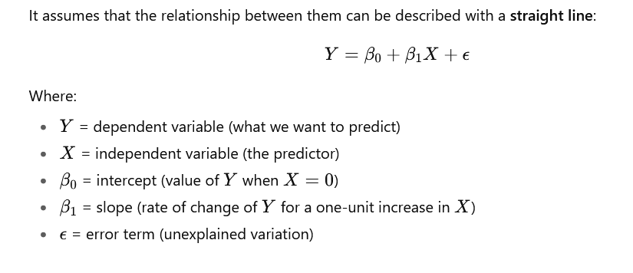
Simple Linear Regression (Refer the Linear Regression PDF)
Simple Linear Regression (SLR) is a statistical method used to model the relationship between two variables:
Independent variable (X) → predictor/explanatory variable.
Dependent variable (Y) → response/outcome variable.

